Slide 1
Decision Trees, Conditionals, and Loops in SikuliX/Jython
Author: Nick Belli Date: April 20, 2018

Slide 2
What are Decision Trees?
A Decision Tree is a mapping technique that allows us to visualize deciding factors in any programming path
Understanding the questions we need to answer is essential in creating a good decision tree
Usually starts with common English questions and pseudocode
  “If x happens, I need to do y task. Otherwise I need to do z task”
    Translates to “If x, then y; Else, z”

Slide 3
if/else
Do stuff
If Condition = TRUE
Conditional Expression
Do Stuff
If Condition = FALSE

Slide 4
if/elif/else
Conditional Expression
(If)
If Condition = FALSE
If Condition = TRUE
If Condition = FALSE (else)
Conditional Expression
(elif)
Do Stuff
Do Stuff
If Condition = TRUE
Do Stuff

Slide 5
Example Decision Tree
Stay in the A/C and Play Video Games
> 95° F
Temperature
Go on a bike ride
> 65° F
< 65° F
Make a bonfire and roast marshmallows

Slide 6
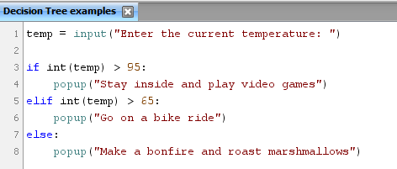
Code Translation: Decision Trees.sikuli
Note the similarity to common English in the blue keywords.
Order of decision is important here to make sure we hit the logic correctly.
Capturing the largest number first hits the first logic section.
Then, the remaining logic between 65 and 95 is captured in the second section.
The last section captures anything not caught by the first two.
  NOTE: The last option can return false positives if not checked in the code.

Slide 7
Looping Conditions
Runs logic until the condition is met
  While Loops
    While (condition is TRUE) – Do stuff
      Can be counter controlled or Sentinel Controlled
  For Each Loops
    Loops until the end of the condition is met
      For each item in this list, do actions.

Slide 8
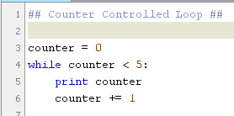
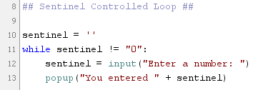
While Loops
Counter Controlled
Sentinel Controlled
Useful for times when a task needs to be repeated a certain number of times.
Useful for creating menus or instances where a defined condition will always end the loop logic.

Slide 9

For Loops
Useful if there is a defined set of information
i.e. “For each employee in this set, add 8 hours of pay”
- OR -
“For each record in this database table, complete the logical steps to enter the information” (Nested Conditions)

Slide 10
Resources
The Definitive Guide to Jython: Python for the Java Platform
  http://www.jython.org/jythonbook/en/1.0/LangSyntax.html#
DecisionTrees.sikuli
WhileLoopsAndForLoops.sikuli
SimpleCalculatorApp.sikuli

